Slide 1
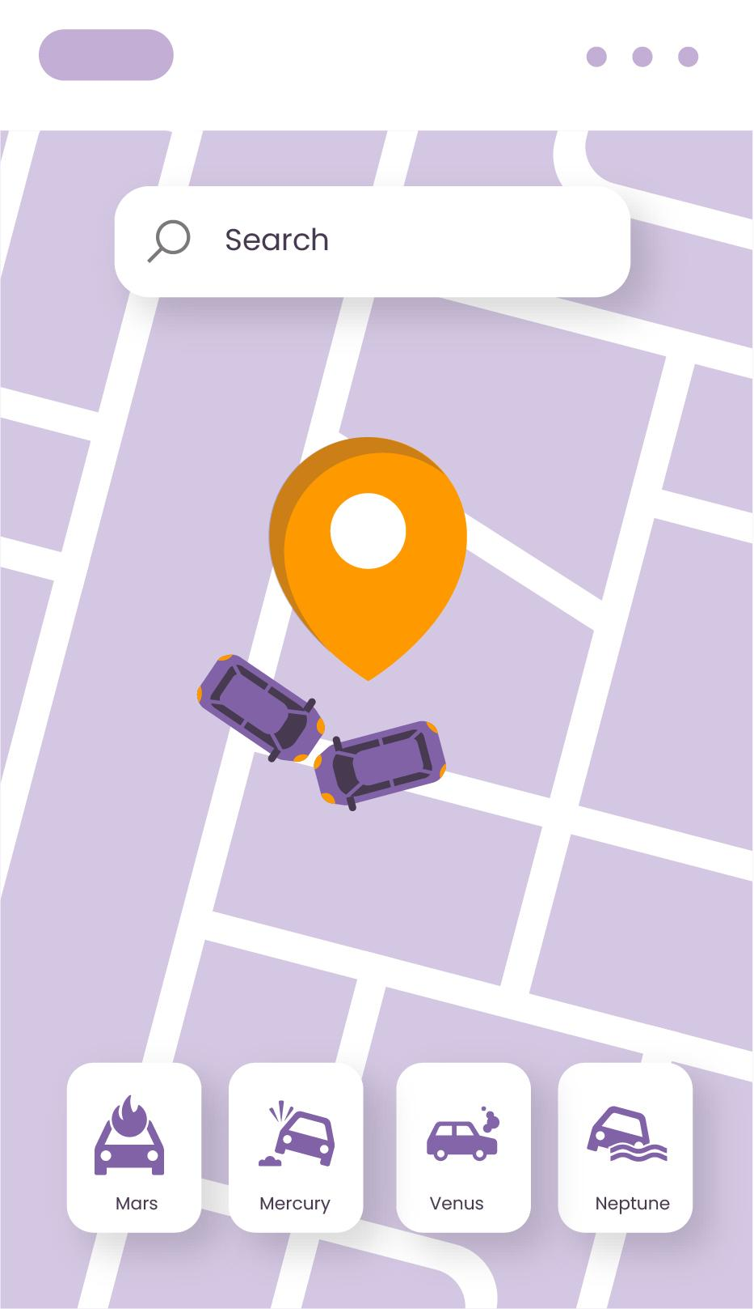
Traffic Congestion Prediction in Saudi Arabia Cities
Khalid – Osama - Mohammed

Slide 2
Project Objective
Problem Statement
Project Goals
Traffic congestion is a major problem in large Saudi cities.
Causes delays, reduced mobility, and environmental impact.
Analyze congestion patterns.
Compare congestion levels between cities (Low, Moderate, or High).
Predict traffic congestion using model.

Slide 3
Data Collection and Dataset
Real-time traffic congestion dataset focused on Saudi Arabia cities
Cities included: Riyadh, Jeddah, Dammam, Makkah.
Main features:
City: The Saudi city where the traffic data was recorded.
TrafficIndexLive: A real-time index that represents the overall level of traffic congestion.
JamsDelay (minutes): The average delay in minutes caused by traffic congestion.
JamsLength (kilometers): The total length of traffic jams measured in kilometers.
Datetime: The date and time when the traffic data was recorded.

Slide 4
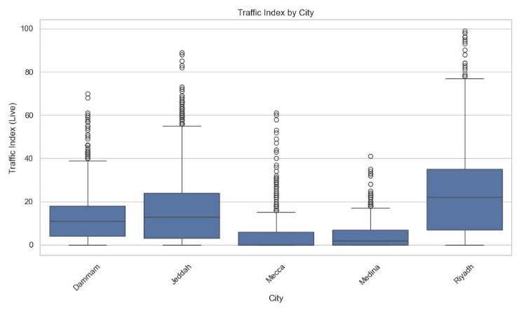
Data Preparation
Removed non-Saudi cities and duplicate records.
Handled missing values by removing incomplete rows.
Extracted time-based features (Hour, Weekday, IsWeekend).
Normalized numerical features using Min-Max scaling.
Outliers detected using Z-score and retained.

Slide 5
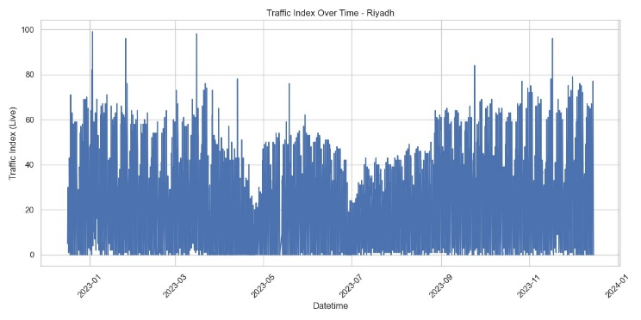
Exploratory Data Analysis
Riyadh shows the highest congestion levels.
Strong correlations between traffic metrics.

Slide 6
Modeling Approach
Classification problem: Predict traffic congestion levels.
Dataset split:
60% training
40% testing
Models applied:
Gradient Boosting
Random Forest
Logistic Regression
Naive Bayes
Support Vector Machine (SVM)

Slide 7
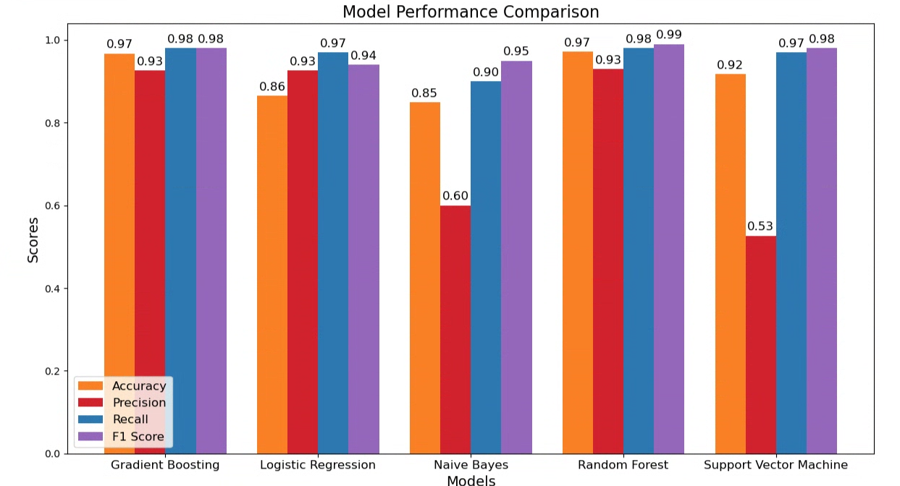
Model Performance Results
Gradient Boosting achieved the highest overall performance.

Slide 8
Conclusion
The project successfully analyzed traffic congestion in Saudi cities.
Machine learning models can accurately predict congestion levels.
Results support intelligent traffic management and smart city initiatives.
Gradient Boosting is the most effective model.

Slide 9
Thank You

